Slide 1
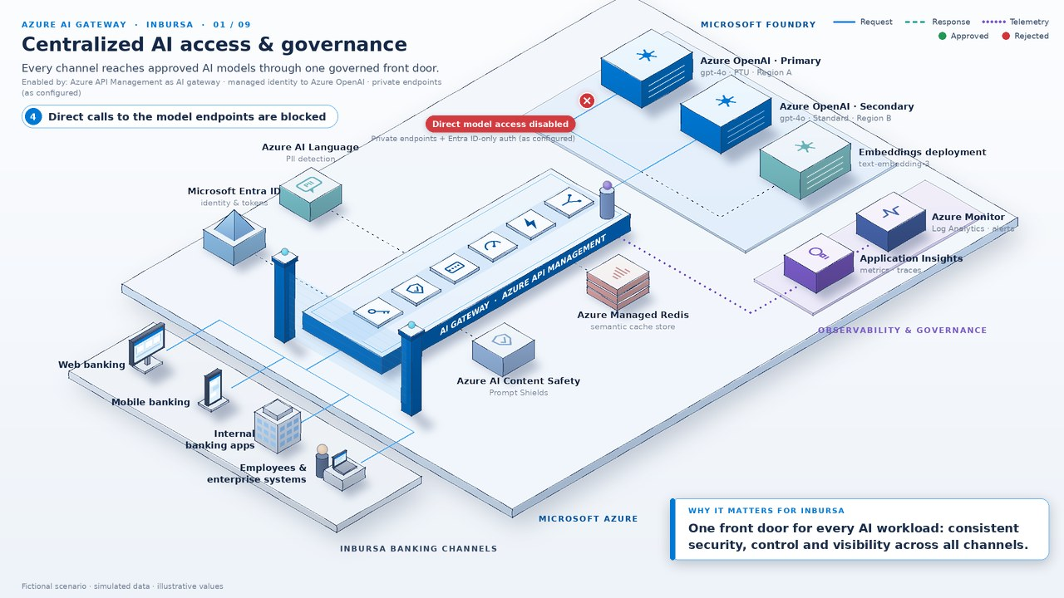
AZURE AI GATEWAY BRIEFING
Governing Generative AI at Scale with Azure AI Gateway
Azure API Management as the control plane for Inbursa's AI workloads
Sebastian Adan
Sr. Cloud Solution Architect, Microsoft Mexico
October 2026
Notes:
Thank you for the time today. Over the next few minutes I want to show how Azure API Management, used as an AI gateway, can become the single control plane for every generative AI workload at Inbursa. The picture behind me is the architecture we will walk through: your channels on the left, the gateway in the middle, and the approved Microsoft Foundry models on the right. Everything you will see is a fictional scenario with illustrative values, designed to make the capabilities concrete for a bank. My goal is that you leave with a clear view of what the gateway does, what it does not do, and a practical path to a pilot.

Slide 2
THE CHALLENGE
Direct-to-model AI does not scale safely
01
Direct model calls
Channels and teams call model endpoints directly.
02
Keys everywhere
API keys copied across apps, scripts and pipelines.
03
Uneven guardrails
Each team builds, or skips, its own safety checks.
04
Capacity contention
One app's spike can exhaust shared PTU and quota.
05
Opaque token spend
No per-channel view of who consumes what.
06
Audit expectations
Risk and audit need a traceable record per interaction.
Result: uneven security, unpredictable cost and thin evidence for audit.
Notes:
This is the pattern we see in most banks as generative AI moves from experiments to production. Web banking, mobile, internal applications and employee tools each start calling models directly, and each team copies its own API keys. Guardrails end up uneven, because every team decides on its own how much safety checking to do. Capacity becomes a shared-resource problem: one busy application can consume the PTU or quota everyone else depends on. And when finance, risk or audit ask who used what, and what was sent, the answers are scattered or missing.

Slide 3
WHAT AN AI GATEWAY IS
One governed front door for AI
A single, governed entry point between every AI consumer and every approved model, agent and tool.
Secure
Identity, safety, PII masking
Scale
Token limits, routing, caching
Monitor
Token metrics, logs, alerts
Govern
One policy set, every channel
Works with: Azure OpenAI and Microsoft Foundry models · OpenAI-compatible, Anthropic and Vertex-style LLM APIs · MCP tools and A2A agents
Notes:
An AI gateway is simply one governed front door that sits between every AI consumer and every approved model, agent or tool. In Azure, that role is played by Azure API Management with its AI gateway capabilities. It does four jobs: it secures access, it scales and protects shared capacity, it monitors usage, and it applies one consistent set of governance policies across every channel. It works with Azure OpenAI and Microsoft Foundry models, with other OpenAI-compatible, Anthropic and Vertex-style APIs, and it can also front MCP tools and A2A agents as your agent landscape grows. The diagram on the right is the reference architecture that every animation in this deck uses.

Slide 4
CAPABILITY MAP
Nine capabilities, three outcomes
Security & safety
Scale & resilience
Visibility & governance
Who can call, and what can pass
Fair capacity, high availability
One front door, full traceability
2
Authentication & access control
3
Rate limiting & token quotas
1
Centralized AI access & governance
5
Prompt & content validation
4
Model routing & fallback
8
Token consumption & cost governance
6
Sensitive data protection
7
Response caching & latency
9
Monitoring, observability & audit
Notes:
Here is the whole story on one slide. We group the nine capabilities into three outcomes your teams care about. Security and safety covers who can call a model and what content is allowed to pass, including personal data. Scale and resilience is about fair use of shared capacity, surviving regional issues, and serving repeat questions faster. Visibility and governance gives you one front door, token-level cost transparency and a full audit trail. The numbers match the animations we will look at next, one capability per slide.

Slide 5
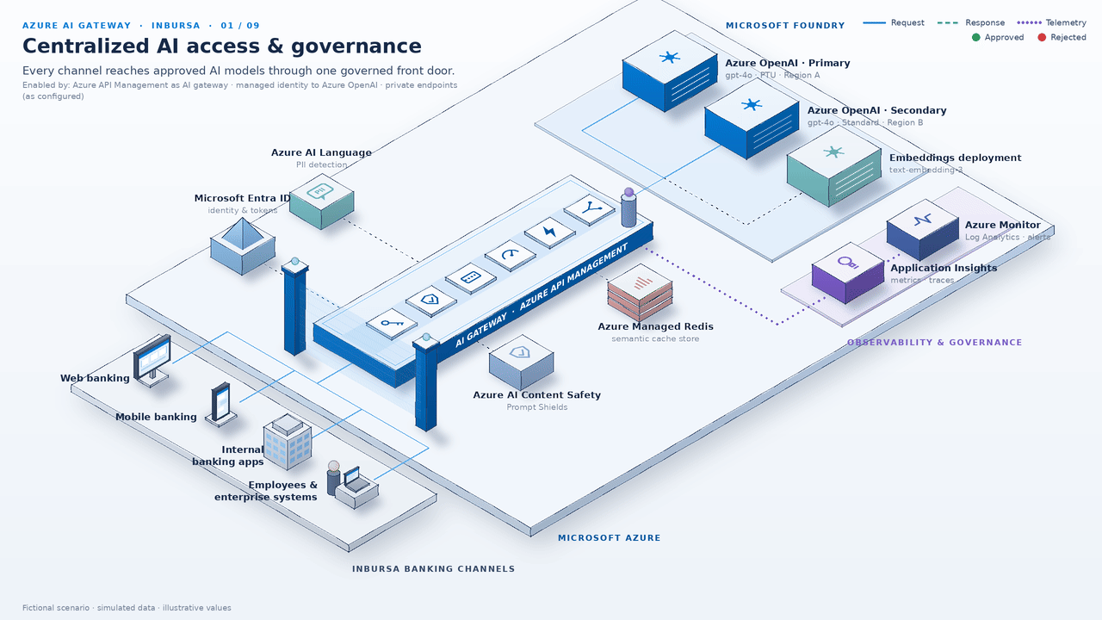
CAPABILITY 01 OF 09 · VISIBILITY & GOVERNANCE
WHAT IT DOES
Gives every channel one governed front door; the gateway calls models with managed identity.
WHY IT MATTERS FOR INBURSA
Same policies for web, mobile, internal apps and employees; no direct calls to model endpoints.
ENABLED BY
APIM as AI gateway · managed identity to Azure OpenAI · private endpoints + Entra ID-only auth on model resources
As configured: blocking direct model access is a network and authentication setting on the model resources, not APIM alone.
Notes:
This first capability is the foundation for everything else. Every Inbursa channel, from web and mobile banking to internal apps and employee tools, reaches the models through one front door. The gateway itself authenticates to Azure OpenAI with a managed identity, so no application needs a model key. Direct calls to the model endpoints are blocked, but I want to be precise here: that block comes from configuring private endpoints and Entra ID-only authentication on the model resources, working together with the gateway. The result is one place where security, cost and audit policies are applied consistently.

Slide 6

CAPABILITY 02 OF 09 · SECURITY & SAFETY
WHAT IT DOES
Validates Microsoft Entra ID tokens on every call: issuer, audience and role claims.
WHY IT MATTERS FOR INBURSA
Expired or invalid tokens get a 401 before the model; no model keys live in client apps.
ENABLED BY
validate-azure-ad-token or validate-jwt policy · Microsoft Entra ID · managed identity
Illustrative scenario. Roles, audiences and app registrations are defined per application in Microsoft Entra ID.
Notes:
Authentication is where the gateway starts every request. Each call must carry a Microsoft Entra ID token, and the gateway checks the issuer, the audience and the role claims before anything else happens. If a token is expired or invalid, the caller gets a 401 and the request never reaches a model. Because the gateway uses managed identity toward the backend, client apps never hold model keys, which removes a whole class of secret-sprawl risk. Your identity team keeps control of who gets which role.

Slide 7
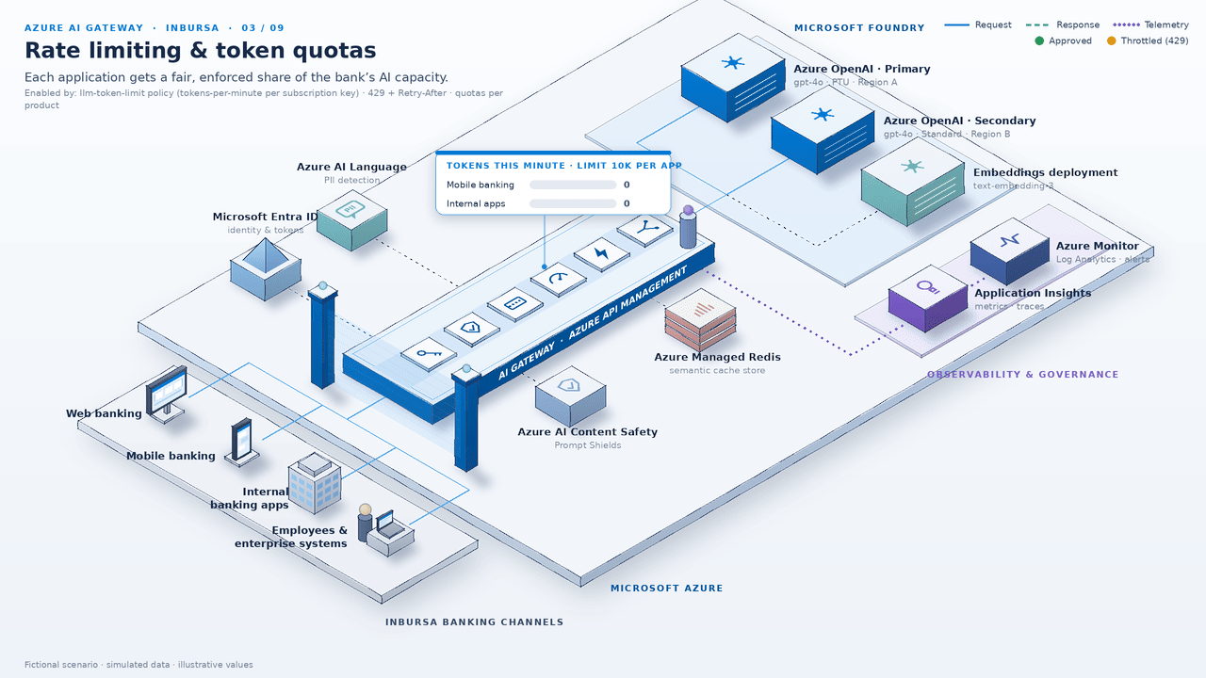
CAPABILITY 03 OF 09 · SCALE & RESILIENCE
WHAT IT DOES
Enforces tokens-per-minute limits, plus optional token quotas, per app or subscription.
WHY IT MATTERS FOR INBURSA
One app's spike can't starve others on shared PTU; over the limit returns 429 + Retry-After.
ENABLED BY
llm-token-limit policy (TPM + optional quotas) · APIM products and subscriptions
Token limits shown are illustrative; actual values are set per app and environment during design.
Notes:
Shared PTU capacity is valuable, and it needs fair-use rules. With the token limit policy, the gateway counts tokens per application or subscription and enforces a tokens-per-minute ceiling, with optional longer-term token quotas. When an app goes over its limit it receives a 429 with a Retry-After header, so well-behaved clients back off cleanly. The important point for Inbursa is isolation: one channel's spike, say a marketing campaign, cannot starve the customer assistant. The numbers in the animation are illustrative only.

Slide 8

CAPABILITY 04 OF 09 · SCALE & RESILIENCE
WHAT IT DOES
Routes to a priority-based backend pool: PTU primary, Standard secondary in another region.
WHY IT MATTERS FOR INBURSA
On 429s or errors the circuit breaker opens and requests retry to the secondary, with no app change.
ENABLED BY
APIM backends and load-balanced pools · circuit breaker · retry policy
Regions, deployments and thresholds are illustrative.
Notes:
Resilience is the next concern for any customer-facing workload. The gateway can group model deployments into a load-balanced backend pool with priorities, for example a PTU deployment in region A as primary and a Standard deployment in region B as secondary. If the primary starts returning 429s or errors, the circuit breaker opens and the retry policy sends traffic to the secondary. Applications do not change at all; they keep calling the same gateway endpoint. When the primary recovers, traffic flows back automatically.

Slide 9
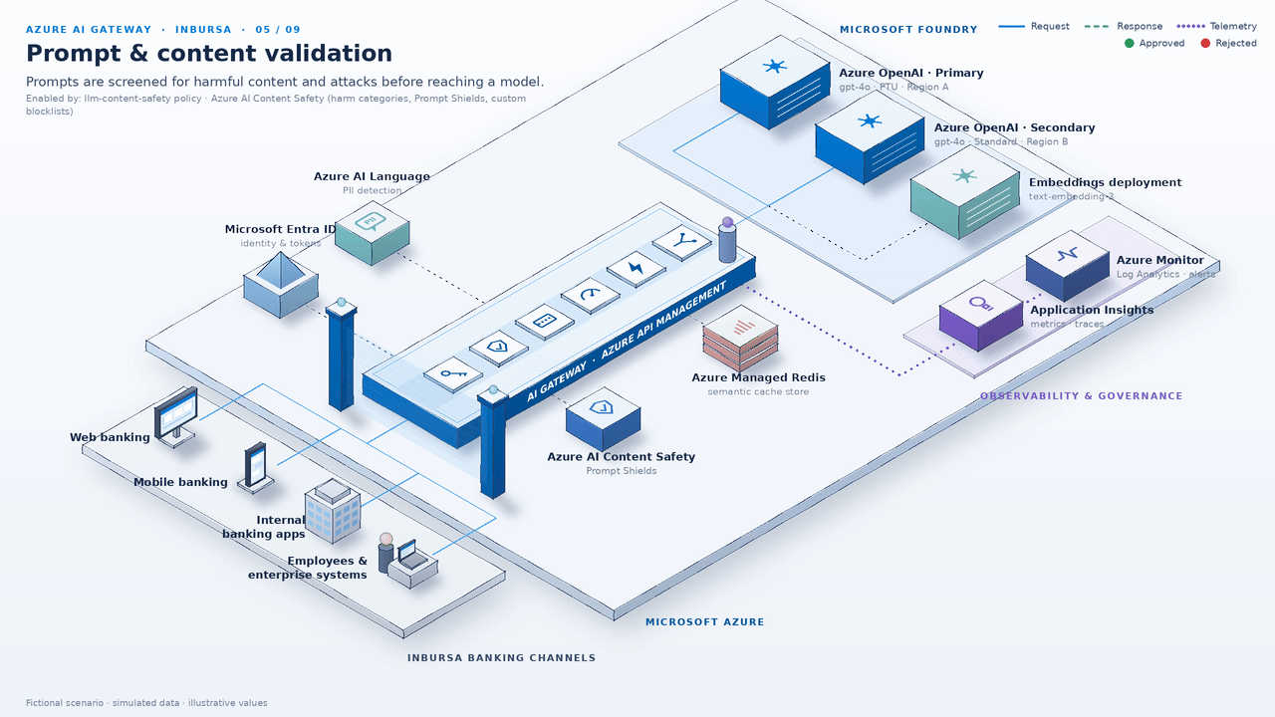
CAPABILITY 05 OF 09 · SECURITY & SAFETY
WHAT IT DOES
Screens prompts, and optionally responses, with Azure AI Content Safety: harm categories, Prompt Shields, blocklists.
WHY IT MATTERS FOR INBURSA
Flagged jailbreak or injection attempts get a 403, so the model never receives them.
ENABLED BY
llm-content-safety policy · complements model content filters and app controls
Categories, severity thresholds and custom blocklists are configured per API.
Notes:
Here the gateway acts as a content checkpoint. Before a prompt is forwarded, the content safety policy sends it to Azure AI Content Safety, which checks harm categories, runs Prompt Shields to detect jailbreak and prompt-injection attempts, and applies any custom blocklists you define. If something is flagged, the caller gets a 403 and the model never sees the request. This complements, rather than replaces, the content filters on the model deployment and the controls inside each application. Thresholds are a design decision we would set together with your risk team.

Slide 10

CAPABILITY 06 OF 09 · SECURITY & SAFETY
WHAT IT DOES
A custom policy calls Azure AI Language PII detection and masks entities, e.g. [PERSON], [PHONE].
WHY IT MATTERS FOR INBURSA
Personal data is masked before it reaches the model; logs keep only the redacted text.
ENABLED BY
Custom policy pattern (send-request + set-body), not a built-in policy
PII masking is a custom pattern; it complements DLP, data classification and app-level controls.
Notes:
For a bank, personal data is the most sensitive part of any prompt. This capability is a custom policy pattern, not a built-in feature: the gateway sends the prompt to Azure AI Language PII detection, then rewrites the body so entities like names and phone numbers become placeholders such as PERSON or PHONE. The model only sees the masked text, and the logs keep the redacted version too. I want to be clear that this complements your DLP, data classification and application-level controls; it does not replace them. We would validate entity types and accuracy during the pilot.

Slide 11
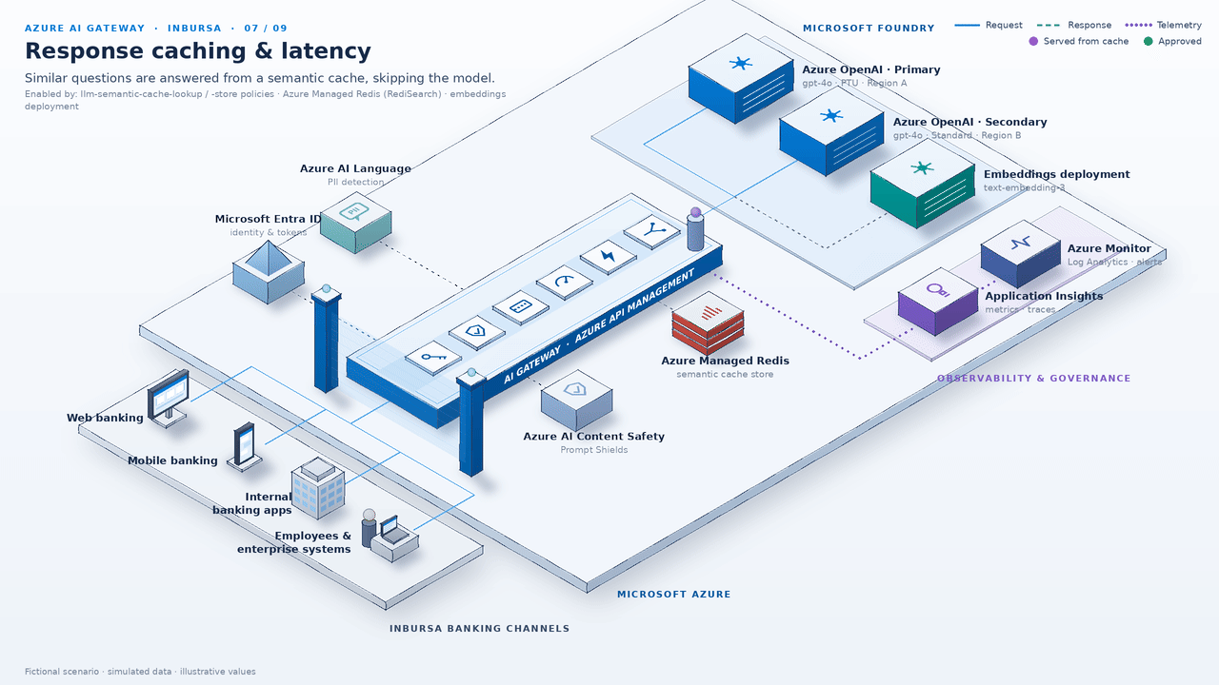
CAPABILITY 07 OF 09 · SCALE & RESILIENCE
WHAT IT DOES
Embeds each prompt and looks up similar ones in Azure Managed Redis; a hit returns the cached answer.
WHY IT MATTERS FOR INBURSA
Faster answers to repeat questions (illustrative ~0.3 s vs ~2.4 s) with no completion tokens.
ENABLED BY
llm-semantic-cache-lookup / -store · Azure Managed Redis (RediSearch) · embeddings deployment
Latencies and the 0.95 similarity threshold are illustrative. Scope cache keys so personalised answers are never shared.
Notes:
Many banking questions repeat, such as card limits, branch hours or how to reset a password. With semantic caching, the gateway embeds each prompt and looks for a sufficiently similar prompt in Azure Managed Redis. On a hit it returns the stored answer immediately, in the illustration about 0.3 seconds instead of 2.4, and no completion tokens are consumed. The key design caveat is scope: cache keys must be partitioned so that personalised answers are never shared between customers. This works best for general FAQ-style content.

Slide 12
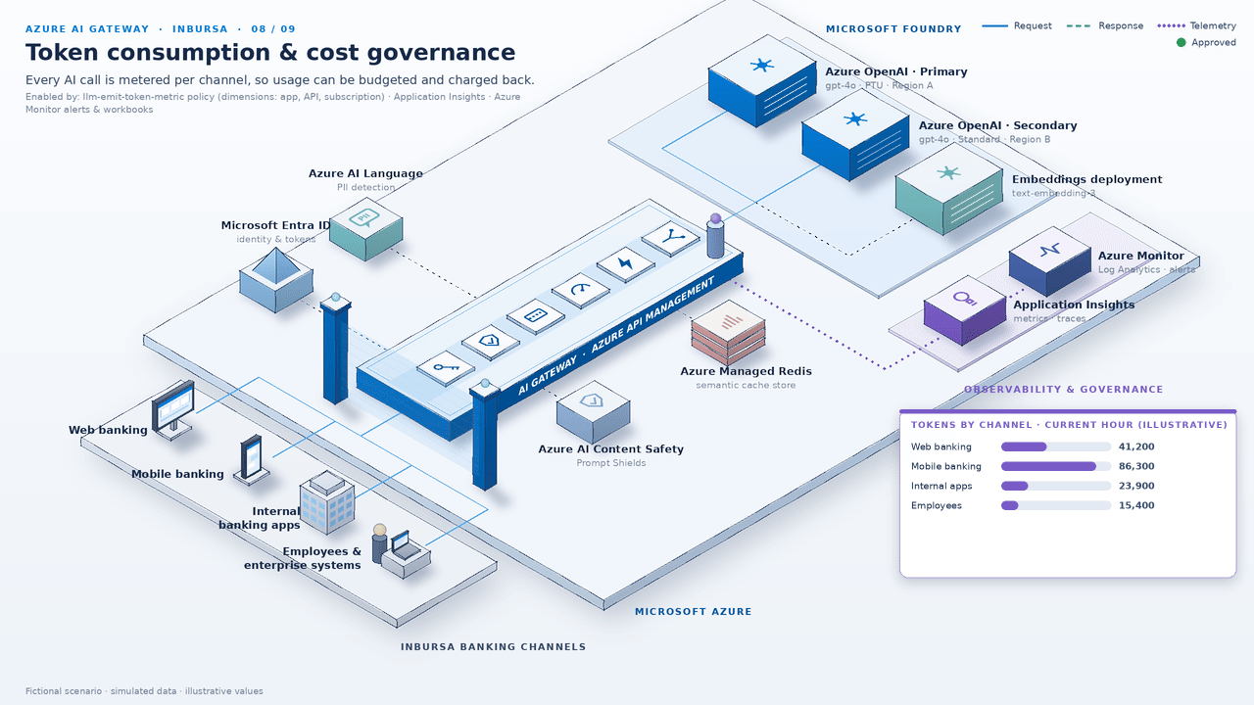
CAPABILITY 08 OF 09 · VISIBILITY & GOVERNANCE
WHAT IT DOES
Emits prompt, completion and total token metrics per channel, app, API and subscription.
WHY IT MATTERS FOR INBURSA
Powers FinOps dashboards, budgets, alerts and chargeback by business line.
ENABLED BY
llm-emit-token-metric policy · Application Insights · Azure Monitor alerts and workbooks
Figures, including the 80% budget alert, are illustrative; the scenario is fictional.
Notes:
Once all traffic flows through one gateway, measuring cost becomes straightforward. The emit token metric policy sends prompt, completion and total token counts to Application Insights, tagged with dimensions such as channel, application, API and subscription. From there you can build workbooks, set budgets, and trigger Azure Monitor alerts, for example when a team reaches 80 percent of its monthly allocation. That gives finance and the platform team a basis for chargeback or showback by business line. The values in the animation are illustrative.

Slide 13
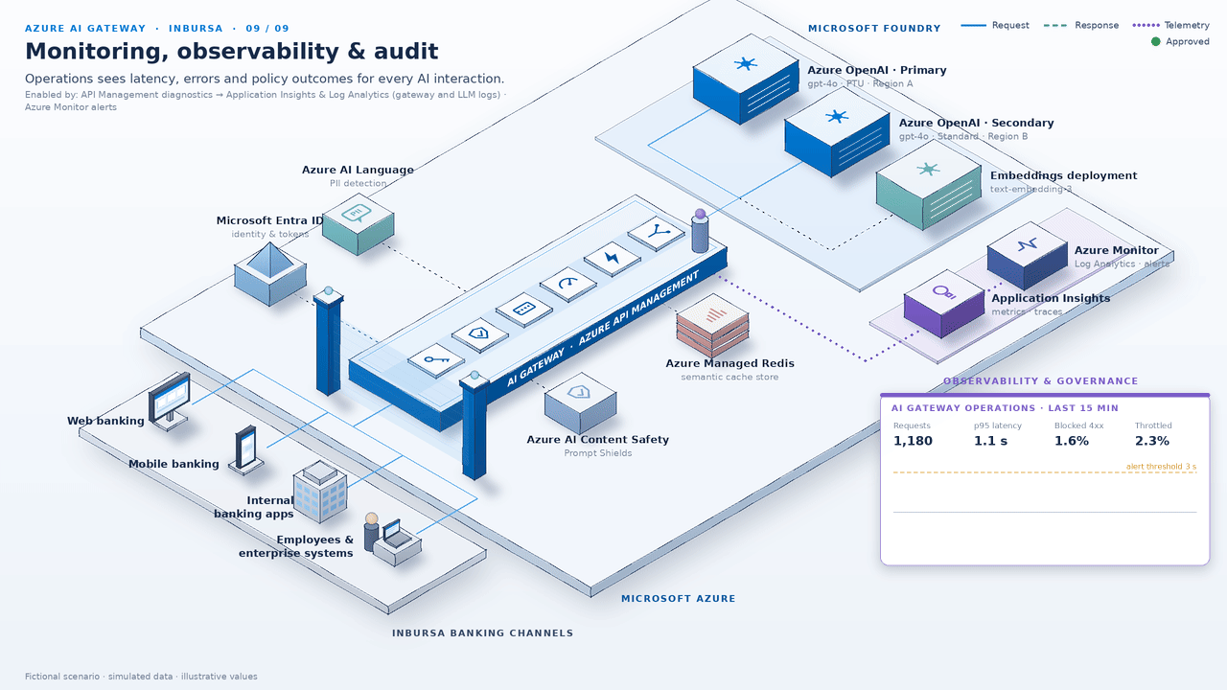
CAPABILITY 09 OF 09 · VISIBILITY & GOVERNANCE
WHAT IT DOES
Sends latency, errors, policy outcomes and optional prompt/completion logs to Log Analytics.
WHY IT MATTERS FOR INBURSA
Every interaction leaves a traceable record for risk, audit and operations teams.
ENABLED BY
APIM diagnostic settings to Application Insights & Log Analytics (gateway + LLM logs) · Azure Monitor alerts
Prompt and completion logging is optional and should follow Inbursa's data-retention and privacy policies.
Notes:
The final capability is observability and audit. Through diagnostic settings, the gateway sends request logs, latency, errors and policy outcomes to Application Insights and Log Analytics, and it can optionally log prompts and completions for LLM APIs. Operations teams get alerting on errors and latency through Azure Monitor alert rules. Risk and audit teams get a traceable record for each interaction: who called, which model, which policies applied and what the outcome was. Whether to store prompt content, and for how long, is a decision to align with your retention and privacy policies.

Slide 14
REFERENCE POLICY PIPELINE
One ordered policy pipeline
INBOUND · IN ORDER
Validate token
Content safety
PII masking (custom)
Token limit
Cache lookup
Route backend
Foundry model
OUTBOUND · ON THE RESPONSE
Then back to the channel
Log & trace
Emit token metrics
Cache store
Capability | APIM policy / feature | Supporting Azure service
Authentication & access | validate-azure-ad-token / validate-jwt | Microsoft Entra ID
Prompt & content validation | llm-content-safety | Azure AI Content Safety
Sensitive data (PII) | Custom: send-request + set-body | Azure AI Language
Rate limits & token quotas | llm-token-limit · products | Azure OpenAI PTU / Standard
Semantic caching | llm-semantic-cache-lookup / -store | Azure Managed Redis · embeddings
Routing & fallback | Backend pools · circuit breaker · retry | Microsoft Foundry deployments
Token cost governance | llm-emit-token-metric | Application Insights
Monitoring & audit | Diagnostic settings (gateway + LLM logs) | Log Analytics · Azure Monitor
Notes:
This slide shows how the capabilities fit together as one pipeline on each request. On the way in, the gateway first validates the token, then checks content safety, masks personal data with the custom pattern, enforces the token limit, looks for a cached answer, and only then routes to the right model backend. On the way back, it stores the response in the cache when appropriate, emits token metrics and writes logs. The order matters: for example, we reject bad tokens and unsafe prompts before spending any tokens. The table maps each capability to the specific policy or feature and the Azure service behind it; centralized access through managed identity and private endpoints underpins all of them. This is a reference order that we would validate during design.

Slide 15
SHARED RESPONSIBILITY
One layer in defense-in-depth
What the gateway provides
What it does not do on its own
✓
Central policy enforcement for AI traffic
✕
Guarantee regulatory compliance (e.g., CNBV, Banxico)
✓
Identity-based access to approved models
✕
Prevent every possible data leak
✓
Content and PII screening, as configured
✕
Replace identity management
✓
Token limits, routing and caching
✕
Replace data governance and DLP
✓
Metrics and logs as audit evidence
✕
Replace model content filters or app-level security
Compliance depends on Inbursa's end-to-end controls and assessments.
Notes:
I want to be careful and transparent about scope. The gateway is a powerful enforcement point, but it is one layer in a defense-in-depth design, not the whole design. On its own it does not guarantee regulatory compliance, including CNBV or Banxico expectations, and it cannot prevent every possible data leak. It also does not replace Entra ID identity management, your data governance and DLP programme, the content filters on the model deployments, or security inside each application. What it does provide is consistent enforcement and good evidence that your risk and compliance teams can use in their own assessments.

Slide 16
ADOPTION ROADMAP
A phased path to production
PHASE 1 · WEEKS 0–6
PHASE 2 · WEEKS 6–12
PHASE 3 · WEEK 12+
Foundation
Protection & resilience
Scale & governance
APIM AI gateway in place
Content safety on prompts
PII masking pattern
Import Foundry / Azure OpenAI APIs
Backend pools + circuit breaker across PTU / Standard
Chargeback dashboards and budgets
Entra ID auth + managed identity
Extend to agents and MCP tools
Semantic caching for high-volume FAQs
Token limits per app
Platform-team operating model
Token metrics and logging
All timings are indicative and will be confirmed in the architecture workshop.
Notes:
Here is a practical, phased path. Phase one, roughly the first six weeks, builds the foundation: the gateway itself, the Foundry and Azure OpenAI APIs imported behind it, Entra ID authentication with managed identity, token limits and token metrics with logging. Phase two adds protection and resilience: content safety, backend pools with a circuit breaker across PTU and Standard, and semantic caching for high-volume FAQ scenarios. Phase three scales governance: the PII masking pattern, chargeback dashboards and budgets, extending the gateway to agents and MCP tools, and a platform-team operating model. All of these timings are indicative and we would confirm them together.

Slide 17
NEXT STEPS
Proposed next steps
1
Architecture workshop
With Inbursa security, risk and architecture teams
Pick 1–2 pilot use cases
e.g., employee knowledge assistant, customer virtual assistant
Questions
2
Define quotas, policies and KPIs
Latency, token cost per channel, blocked requests
Sebastian Adan
Sr. Cloud Solution Architect
Microsoft Mexico
3
4
Pilot in non-production
Validate policies, performance and logging end to end
5
Review results, plan rollout
Agree the production path and operating model
Notes:
To make this concrete, I propose five next steps. First, an architecture workshop with your security, risk and architecture teams to agree the target design and the policy order. Second, we pick one or two pilot use cases, for example an employee knowledge assistant and a customer virtual assistant. Third, we define quotas, policies and the KPIs we will measure, such as latency, token cost per channel and the number of blocked requests. Then we run the pilot in a non-production environment and review the results together to plan the rollout. With that, I am happy to take your questions.

